Slide 1
PlaceMe

Slide 2
Problem Overview
Placement
Need Certification
Get Certificates Verified
Start-up incubators
Live sessions with seniors and Alumni
Resume builder
Practice Interviews

Slide 3
Innovations
The app, apart from providing services present in other similar apps like LinkedIn and Bolo, adds the following features:
The app collects the user’s resume, and analyses it to find relevant skills and career preferences. This information is used to find relevant jobs, automatically apply for vacancies (if required), and find other alumni which have similar interests and skillsets.
The app provides a platform to connect with various alumni via live conference sessions which can be used to gather insights and experience.
Based on the profile data, the app will suggest skills not yet acquired which can prove beneficial for applying to a wider set of vacancies. The user will also be notified of recent interviews, certification exams and meetups to help with the same.

Slide 4
Function Description
Home: Feed containing articles, interviews and exam details shared by alumni, vacancies posted by representatives from various companies.
Jobs: Complete listing of vacancies sorted by relevance and date of addition, location, and satisfied requirements.
Alumni: Complete listing of alumni sorted by relevance, matching skillsets. Each alumni can then be contacted individually or in a group live session in a conference call form.
Discuss: Questions posted by various users of the application appear here, and can be browser as per popularity or relevance.
Profile: A presentation of the user’s skills, certification, skill analysis, resumes, and areas of improvement.

Slide 5
Back End
Alumni Connect : WebRTC + Firebase - Calls and Live Streaming
Resume Analysis: NLP
Updates: Firebase Cloud Messaging – Push Notifications
Feeds: MySQL hosted on a cloud platform.
Authentication: Firebase Auth Service

Slide 6
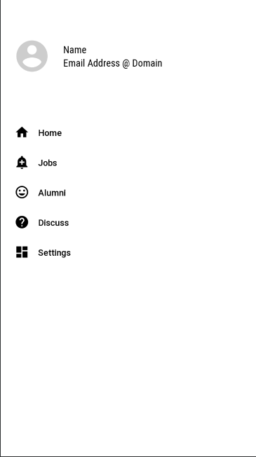
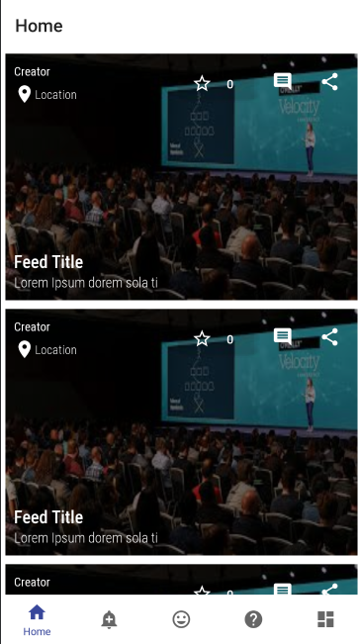
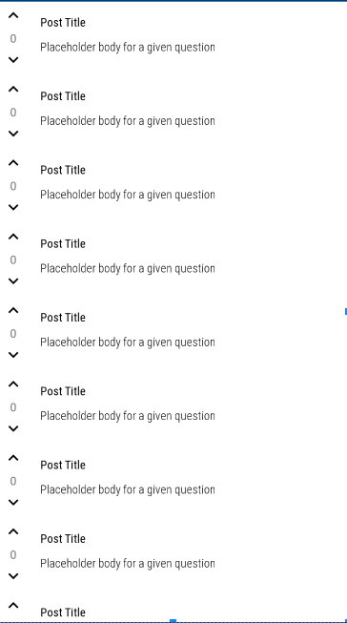

Interface

Slide 7
Feasibility
Development Cost
Maintenance Cost
Data Privacy
Server Requests
Technical Feasibility

